Slide 1

FULL-STACK MERN APPLICATION
Contact Manager
A secure, session-authenticated contact management platform
built with React, Express, and MongoDB
Project Presentation
Contact Manager
1

Slide 2



INTRODUCTION
Project Overview
Contact Manager is a full-stack web application that lets each user securely store, organize, and manage their personal contacts — with authentication, private data ownership, and a clean, minimal interface.
AT A GLANCE
2
Private by design
Core data models
Every contact is scoped to its owner — no user can view or modify another user's data.
9
Full-stack architecture
REST API endpoints
React + Vite client, Express REST API, and MongoDB for persistent storage.
3
Production-style practices
Protected route layers
Session-based auth, hashed passwords, input validation, and clear error handling.
1
Unified design system
Contact Manager
2

Slide 3






GOALS
Project Objectives
Secure authentication
Reliable data modeling
Robust REST API
Implement signup, login, logout and session persistence without exposing sensitive data.
Design clean Mongoose schemas for Users and Contacts with proper relationships.
Build a validated, well-structured CRUD API with correct HTTP status codes.
Usable, minimal UI
Practical features
Strict data isolation
Deliver a professional interface that is easy to navigate on every screen.
Support fast search and category filtering across a user's contact list.
Guarantee that one user can never read or edit another user's records.
Contact Manager
3

Slide 4


TECHNOLOGY
Tech Stack
Client
/client
Server
/server
React 18 + Vite
Node.js + Express
Tailwind CSS
MongoDB + Mongoose
React Router
bcrypt password hashing
lucide-react icons
express-session + connect-mongo
AuthContext (session-aware)
multer file uploads
fetch / axios — credentials: include
CORS with credentials support
Contact Manager
4

Slide 5
ARCHITECTURE
System Architecture
HTTPS + cookie
Mongoose queries
React Client
Express Server
MongoDB Atlas
Vite · Tailwind · Router
REST API · Sessions
Users · Contacts
The client never talks to MongoDB directly. Every request passes through the Express API, which enforces authentication and ownership checks before touching the database.
SERVER FOLDER STRUCTURE
/models /routes /controllers /middleware /config
Contact Manager
5

Slide 6
DATA MODEL
Database Design
User
Contact
name
String
name
String, required
email
String, unique
1 : many
phone
String, required
passwordHash
String
email
String, optional
address
String, optional
notes
String, optional
category
String, optional
owner
ObjectId → User
Contact Manager
6

Slide 7

SECURITY
Authentication Flow
Session-based authentication — not JWT
1
2
3
4
5
Sign up
Log in
Session stored
Protected requests
Log out
Password is hashed with bcrypt before the user is saved.
Credentials verified with bcrypt.compare; session created.
connect-mongo persists the session in MongoDB; only the userId is kept — never the password.
requireAuth middleware checks req.session on every contacts route; 401 if missing.
Session is destroyed on the server, clearing access immediately.
Session cookies are sent with credentials: 'include' on every client request, so authenticated state persists across page reloads.
Contact Manager
7

Slide 8
API DESIGN
Backend REST API
METHOD
ENDPOINT
DESCRIPTION
POST
/api/auth/signup
Create account, hash password, start session
POST
/api/auth/login
Verify credentials, start session
POST
/api/auth/logout
Destroy the active session
GET
/api/auth/me
Return the logged-in user, or 401
POST
/api/contacts
Create a contact for the current user
GET
/api/contacts
List only the current user's contacts
GET
/api/contacts/:id
Fetch one contact (ownership checked)
PUT
/api/contacts/:id
Update a contact (ownership checked)
DELETE
/api/contacts/:id
Remove a contact (ownership checked)
Contact Manager
8

Slide 9

SECURITY
Security & Data Isolation
Per-user ownership
Hashed passwords only
Every contact stores the owning userId; queries always filter by the logged-in session's user.
bcrypt hashes are stored — plaintext passwords are never persisted or logged.
Session-only identity
Cross-user access blocked
The session holds just the userId; no password or passwordHash ever touches the session store.
Requests for another user's contact return 404 — verified directly with Postman/curl.
Contact Manager
9

Slide 10
CLIENT
Frontend Architecture
1
2
3
App loads
Route guard
Authenticated app
AuthContext calls GET /api/auth/me to check for an existing session.
ProtectedRoute checks auth state; redirects to /login if unauthenticated.
Dashboard, navigation bar, and contact views render with the session user.
KEY BUILDING BLOCKS
React Router
AuthContext
/login · /signup · protected /dashboard route
Shares login/logout functions and user state app-wide
ProtectedRoute
Navigation bar
Wrapper component that gates access to the main app
Shows the logged-in user's name and a logout button
Contact Manager
10

Slide 11



WALKTHROUGH
Application Walkthrough
A quick tour of the five core screens users move through, from first sign-in to managing their contacts.
Login
Sign Up
Dashboard
Returning users sign in with their email and password to reach their private contact directory.
New users register with name, email, and password to create an account before signing in.
The Contact Directory lists every saved contact in a searchable table, with quick stats and category filters (Family, Friend, Work, Other).
Add Contact
Edit Contact
A guided form captures a new contact's name, phone, email, address, category, and notes, with an optional photo upload.
The same form, pre-filled with existing details, lets users update or correct any field in place.
Contact Manager
11

Slide 12
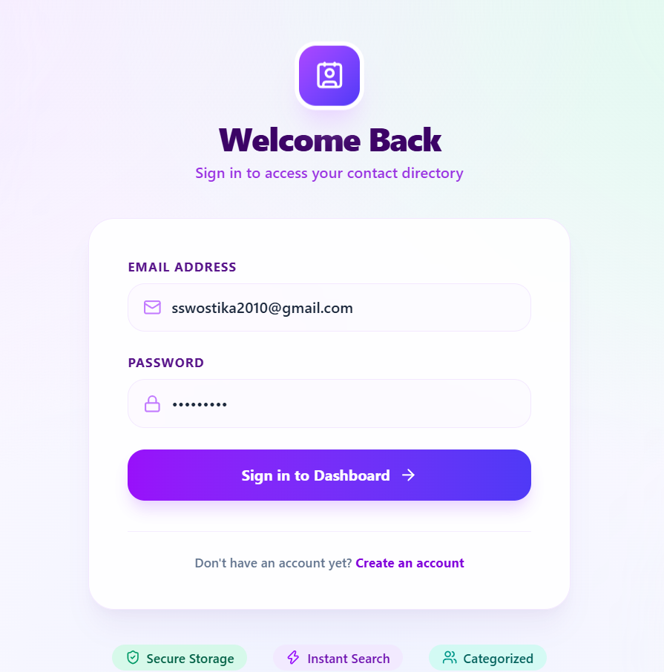
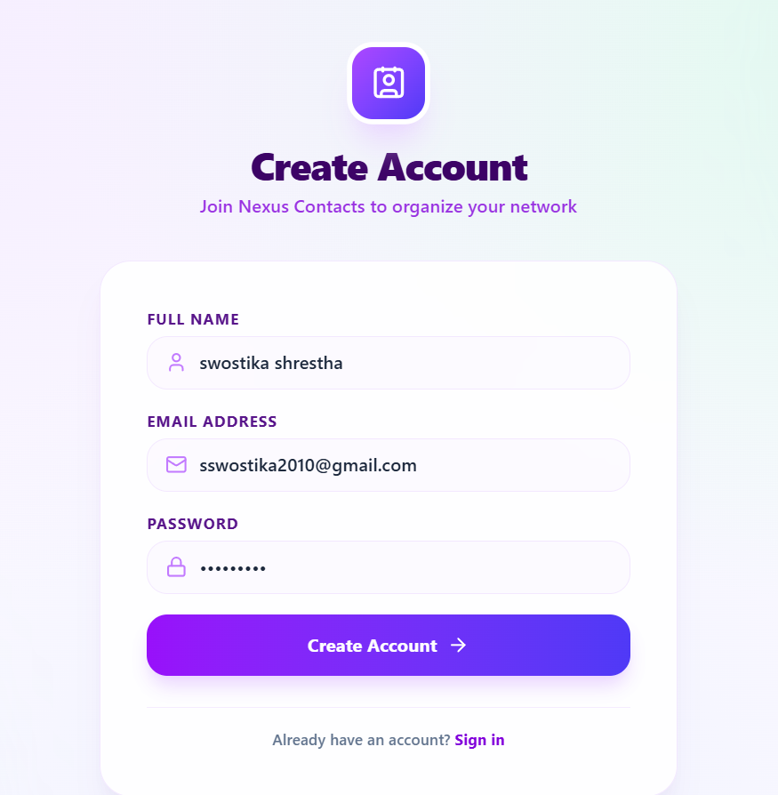
INTERFACE
Authentication — Login & Sign Up
Login
Sign Up
Contact Manager
12

Slide 13
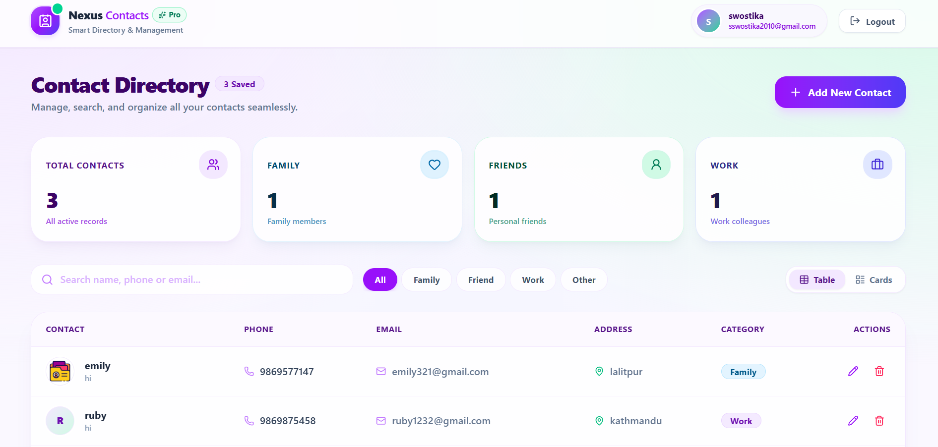
INTERFACE
Contact Dashboard
Contact Manager
13

Slide 14
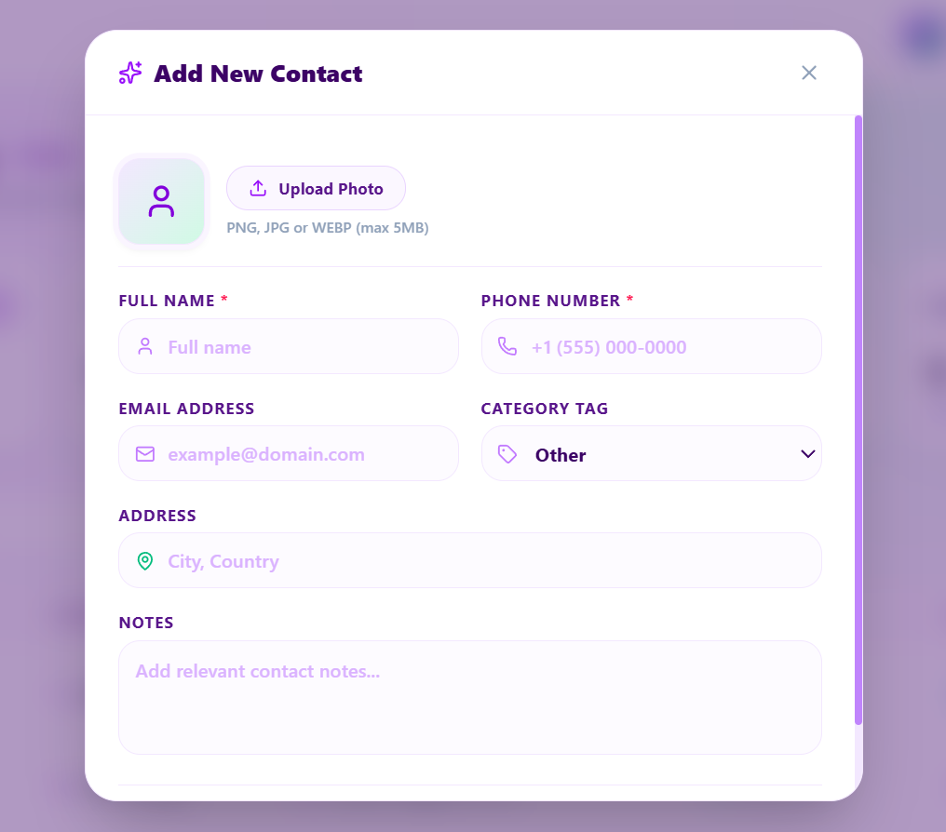
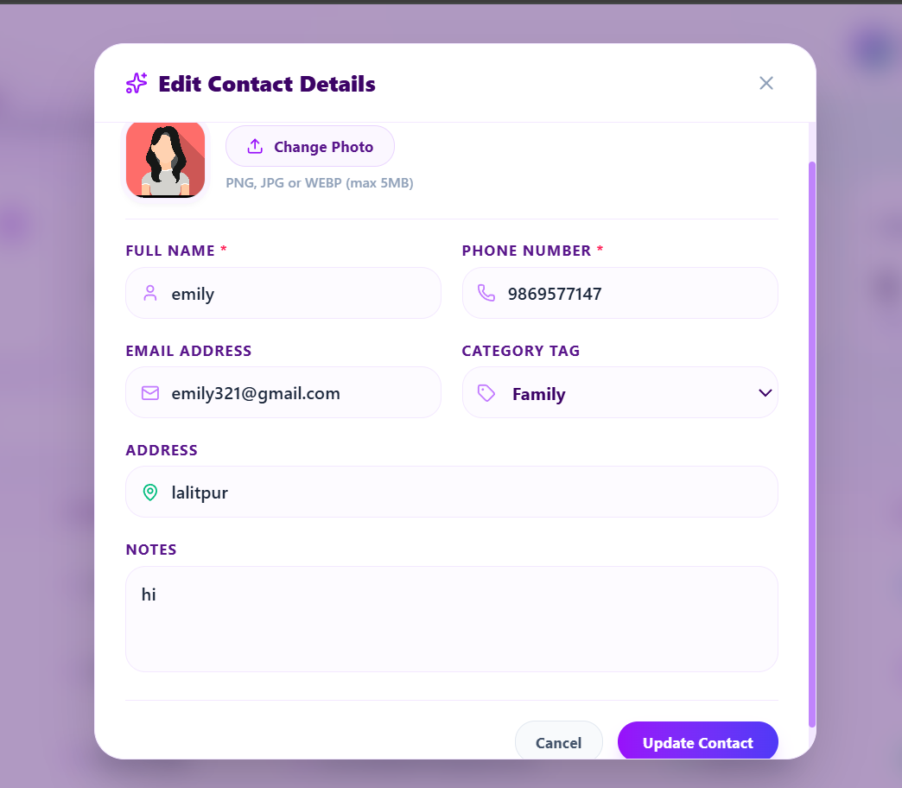
INTERFACE
Add & Edit Contact
Add New Contact
Edit Contact Details
Contact Manager
14

Slide 15




FUNCTIONALITY
Key Features
Search & filter
Full CRUD
Confirm before delete
Search contacts by name and filter the list by category instantly.
Create, view, edit, and delete contacts with a shared, pre-filled form.
A confirmation step protects against accidental data loss.
Categorization
Detail view
Empty & loading states
Organize contacts as Family, Work, Friend, or other custom categories.
Click any contact to see its full details before editing.
Friendly empty state and loading indicators keep the UI clear at all times.
Contact Manager
15

Slide 16
REFLECTION
Challenges & Learnings
CHALLENGE
SOLUTION
Keeping sessions working across client/server origins
Configured CORS with credentials support and sent cookies via credentials: 'include' on every request.
Preventing users from accessing others' contacts
Enforced ownership checks in every controller and validated it directly with Postman before building the UI.
Avoiding a generic, templated interface
Defined a strict minimal design system — flat surfaces, simple borders, consistent spacing — applied to every screen.
Contact Manager
16

Slide 17



CONCLUSION
A Complete, Secure Contact Manager
The project delivers a full-stack application with session-based authentication, a validated REST API, strict per-user data isolation, and a clean, professional interface end to end.
FUTURE ENHANCEMENTS
Contact photo uploads via the existing multer configuration
Shared or grouped contacts between trusted users
Custom, user-defined categories and tags
Rate limiting and stronger session security hardening
Thank You
Questions & Discussion
Contact Manager
17

